Slide 1
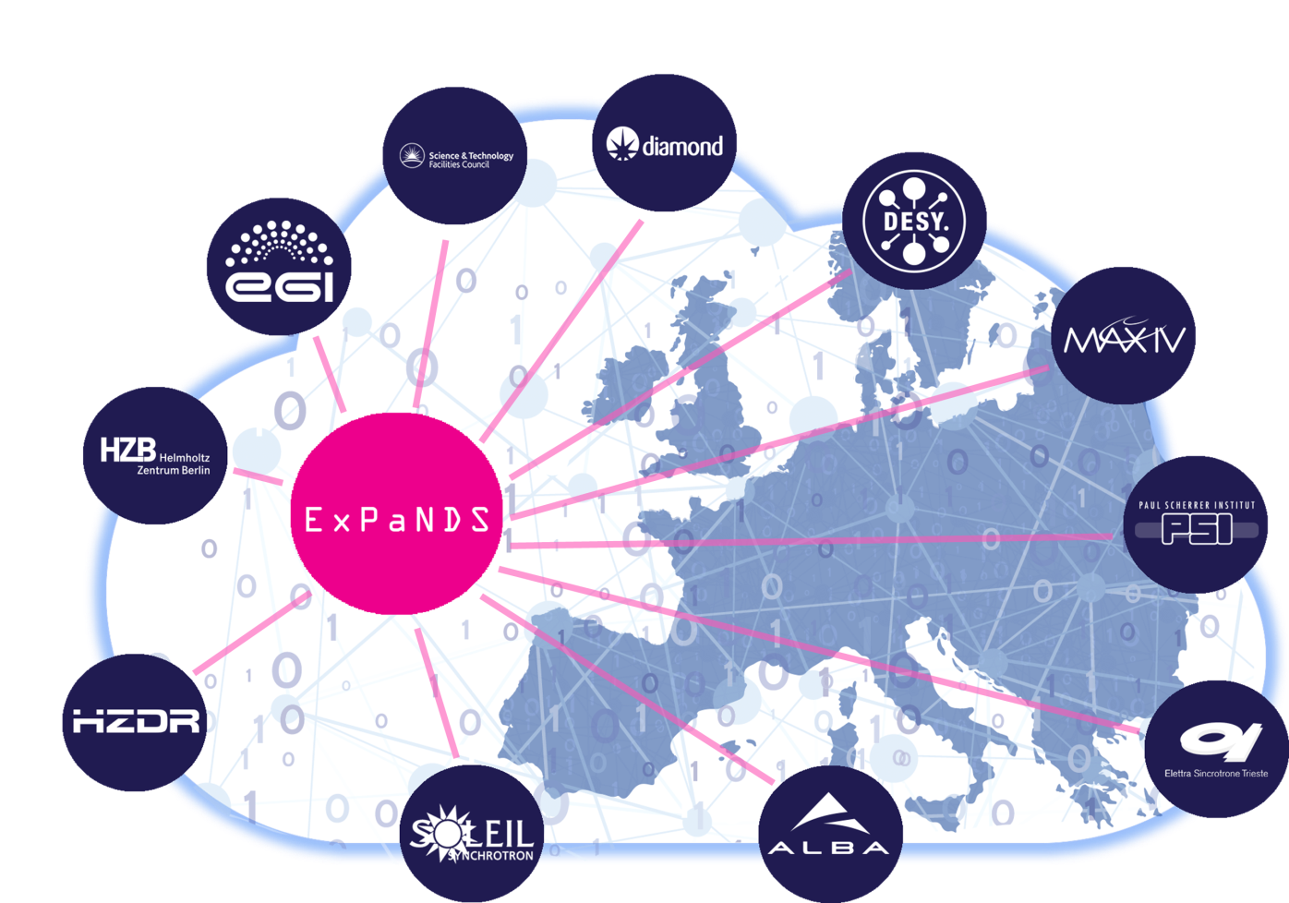

ExPaNDS WP2: Enabling FAIR data PaNOSC WP2: Data Policy and Stewardship
Review and recommend the policies, practises, standards and tools which would develop best practise for FAIR data generation and use in the National Photon and Neutron RIs.
In the policies of the RIs
In the data-generation, collection and analysis process
In Data Management Planning
Raising awareness and competence in FAIR data of our scientific communities.
To guide services to support FAIRness

Slide 2
Why is data stewardship important ?
To support Open Science by making data FAIR
to do this
We need to manage our core product → DATA

Slide 3
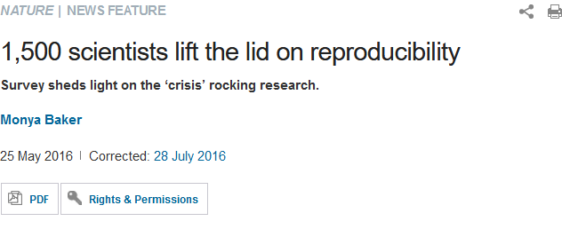
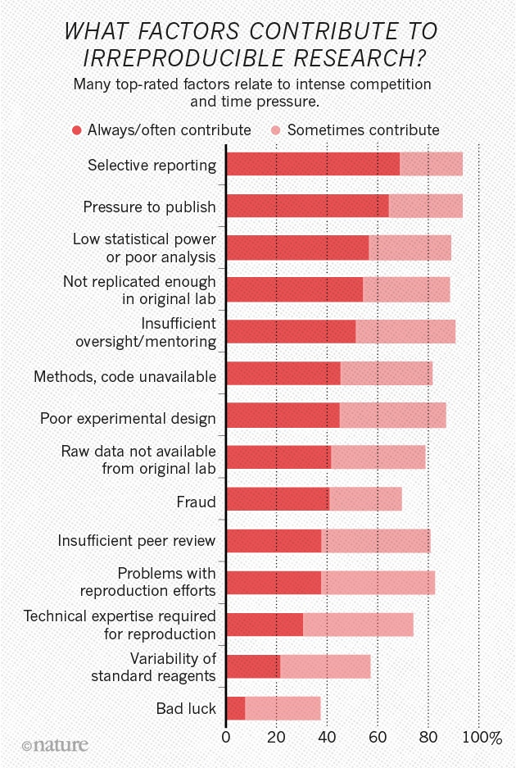
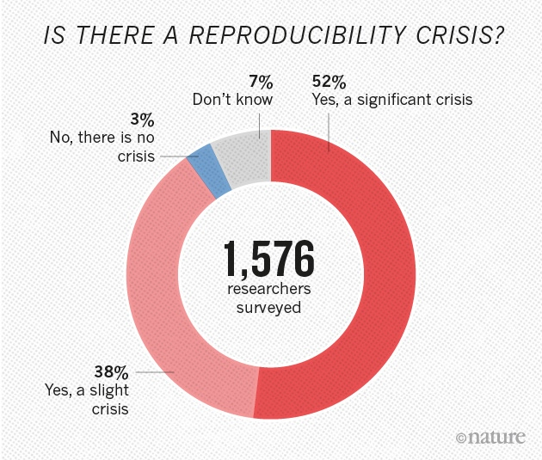
To address this …

Slide 4

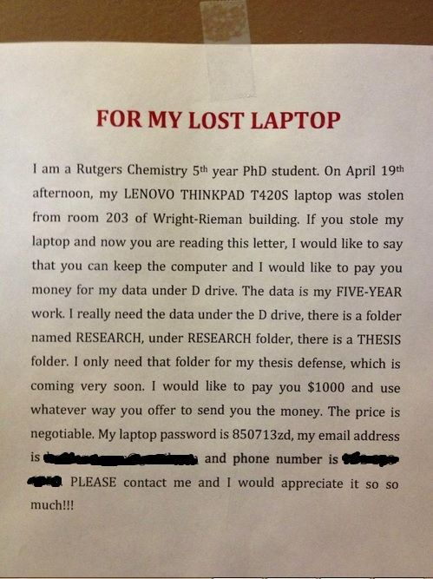
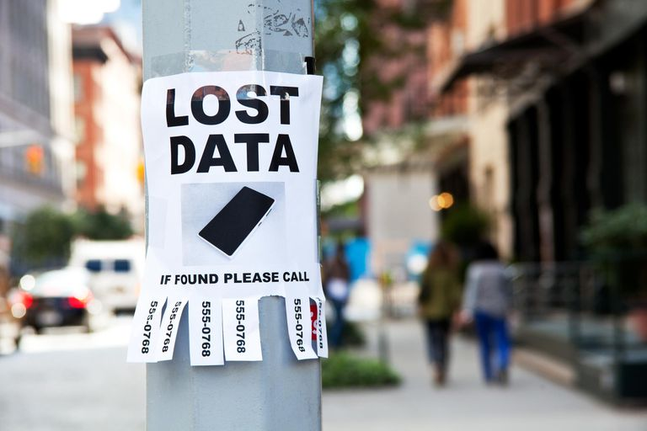
And help avoid this …

Slide 5
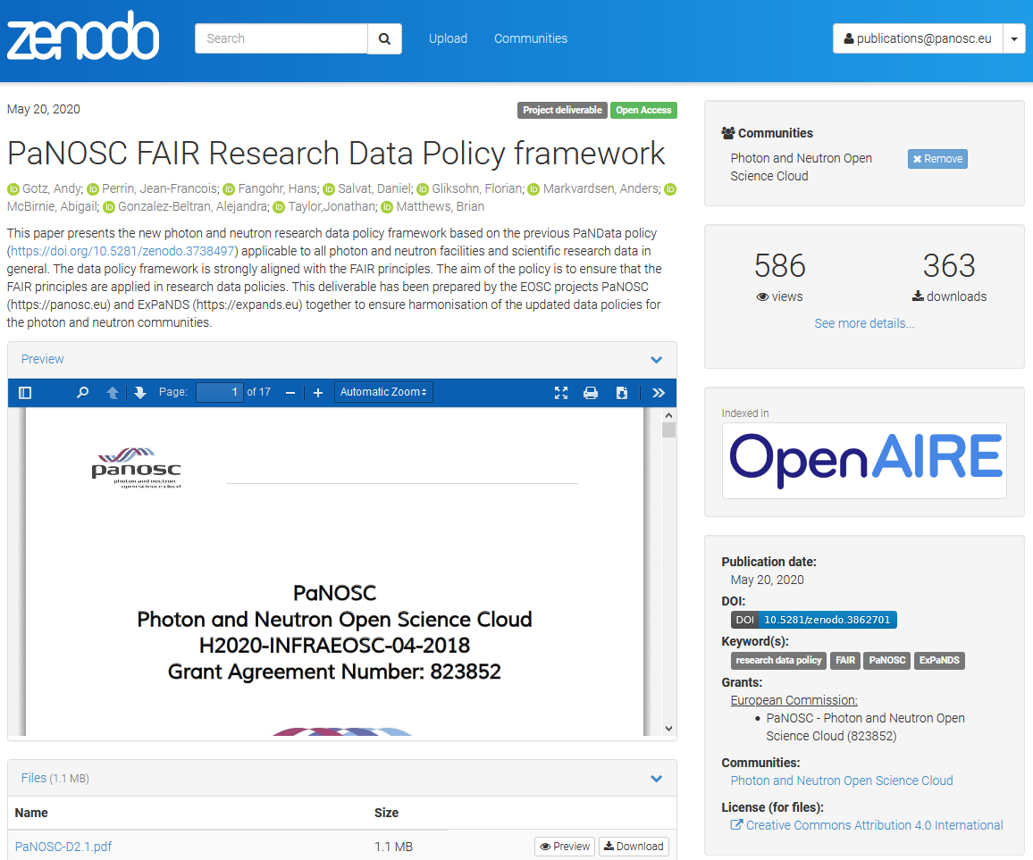
PaNOSC WP2 – FAIR data policy published

Slide 6
PaNOSC WP2 – FAIR data policy framework
FAIR Data Policy framework together with colleagues from ExPaNDS (published on Zenodo)
NEXT STEPs
Each PaNOSC site to adapt it to their needs:
Case #1 – Institute does not have a DP yet
Case #2 – Institute does have a DP
Submit changes to Management for adoption directly or submission to governing bodies
Question : how far is each institute in this process?

Slide 7
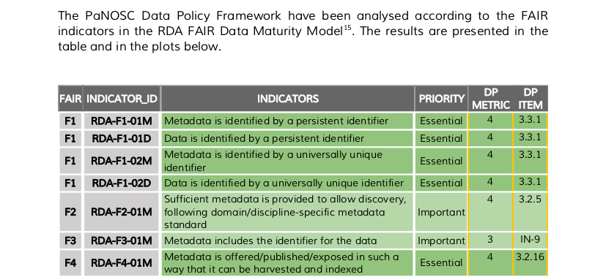
PaNOSC WP2 – FAIR data policy framework
RDA FDMM was used to analyse how FAIR the
data managed by the Data Policy framework is
DOI: 10.15497/rda00050

Slide 8
PaNOSC WP2 – Guidelines + Best practices
Guidelines and best practices from sites who already have implemented a Data Policy were gathered and published on GitHub
NEXT STEPs
Convert to a deliverable which could help other sites still in the process of adopting or implementing a Data Policy
Question : what are the major challenges being faced by sites who are in this process?

Slide 9
PaNOSC WP2 – Guidelines + Best practices
Topics to be covered
Discussing with scientists + management
Data catalogue solutions
Data portal needs
Long term archiving
Metadata standards
Standard techniques
Electronic logbooks
Digital Object Identifiers
ORCID user IDs
Processed data
…

Slide 10
PaNOSC WP2 – Data Management Plans
Data Management Plans are in the process of gathering needs of each site; closely working with ExPaNDS on implementation
NEXT STEPs
Finalise requirements for DMPs for all partners (by December 2020)
Choose a tool for implementing a prototype
Integrate into local proposal systems workflows
Participants: ESS (lead), HZB, ESRF, EuXFEL, CERIC, ELI
Question : which other institutes are interested?

Slide 11
PaNOSC WP2 – Data Management Plans
Goal: pre-fill DMP and update it automatically
DATA DESCRIPTION
Your beamtime will produce the following types of data (prefilled). Can you deal with these?
Are there any existing data from the ESRF (or elsewhere) that you can reuse?
Are there any restrictions on the reuse (and subsequent sharing) of third-party data?
DATA FORMAT
Your data will be produced in the following formats (prefilled). Do you know how to deal with these formats?
Your metadata will comply with the following metadata standards (prefilled). Do you know how to deal with these metadata?
Is your software capable of dealing with the metadata and data formats your data is provided in? If not how do you propose to deal with these formats in your software?
DATA VOLUME
Your beamtime will generate approximately xxx GB/TB/PB volume of data (prefilled). Do you know how to deal with this during and after the experiment?
Do you have sufficient storage or should you include costs for more?
Will the scale of the data pose challenges when sharing or transferring data between sites?
DATA QUALITY
What standards or methods will you use to create the processed data?
DATA PROCESSING
What are your needs for data processing in terms of CPU/GPU and storage?
Who will provide these resources?

Slide 12
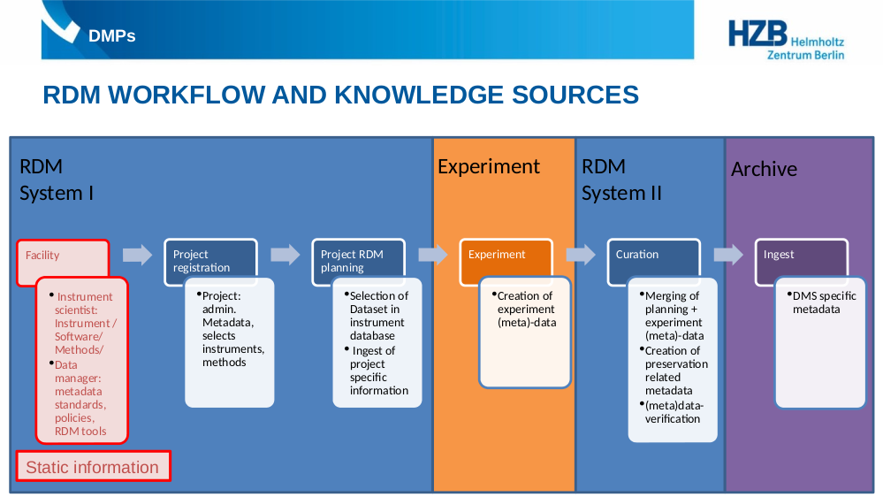
PaNOSC WP2 – Data Management Plans
Credits: Heike Görzig (HZB)

Slide 13

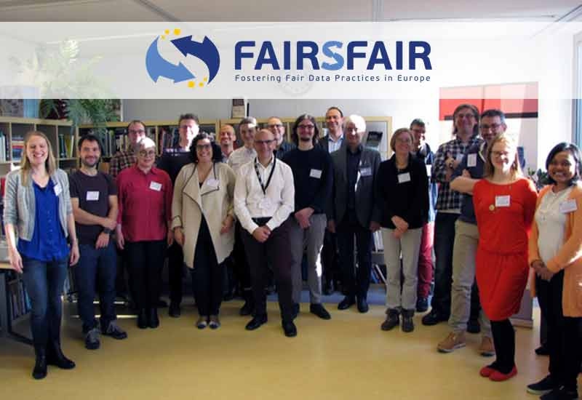
Data repository certification
ESRF is in the process of preparing the CoreTrustSeal application with the help of FAIRsFAIR
An application requires self-certifying a data repository according to 16 criteria
Each criterion requires roughly 1 page of explainations
Application will be submitted in January 2021
Advantage: encourages more systematic approach to building and managing you data repository
“CoreTrustSeal plus FAIR” cf. https://doi.org/10.5281/zenodo.3734896
Question: why not certify your data repository?
https://doi.org/10.5281/zenodo.3828635

Slide 14
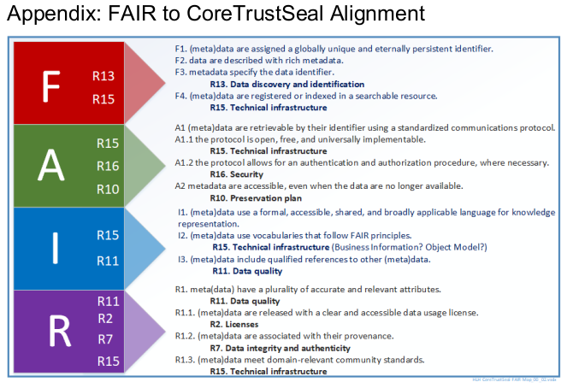

Data repository certification + FAIR
https://doi.org/10.5281/zenodo.3734896

Slide 15

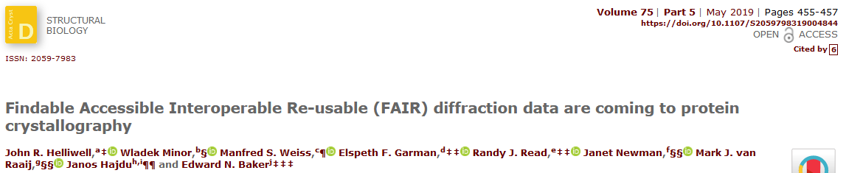
PaNOSC WP2+3 - working with standards bodies
IUCr CommDat committee on data preservation (chaired by J.Helliwell)
Article on data policy in next IUCr Newsletter
Need to continue and strengthen our collaboration with the IUCr committees and community standards e.g. Gold Standard for MX

Slide 16
PaNOSC WP2 KPIs
KPI | Description | Before | 30/11/2019
2.1.1 | number of instruments on which Data Policy is implemented | 53 | 62
2.1.2 | number of techniques / instruments for which metadata are defined | 39 | 41
2.1.25 | number of instruments available | 135 | 139
2.1.26 | Percentage of techniques for which metadata is defined | 113% | 114%
2.1.3 | number of metadata parameters defined | 1310 | 1,880
2.1.4 | number of raw data DOIs | 3591 | 4,612
2.1.5 | number of user defined DOIs | 5 | 12
2.1.6 | number of downloads | 95 | 194
2.1.7 | number of citations of DOIs | 242 | 383
2.1.8 | number of datasets | 1110 | 1,584
2.1.9 | volume of data archived | 5 | 10
2.1.10 | number of datasets cited in publications | 237 | 375

Slide 17
Questions for discussion
What are the major challenges being faced by sites who are implementing a Data Policy?
Who is already using DMPs and/or interested in adopting DMPs for their sites?
What are the major challenges being faced by sites who are in this process?
How can we re-inforce our collaboration with standards bodies and community standards (Gold Standard, CXIDB, PDB, etc.)?

Slide 18
Thank you
Andy Götz & Brian Matthews & WP2 members
Brian.Matthews@stfc.ac.uk & andy.gotz@esrf.fr
https://expands.eu & https://panosc.eu
Special thanks to:
Jonathan Taylor, Dario Roccella, Rudolf Dimper, Florian Glicksohn, Jean-Francois Perrin, Krzysztof Wrona
Brian Matthews, Abigail McBirnie, Daniel Salvat, Alejandra Gonzalez-Beltran, Silvie da Graca Ramos

